Slide 1
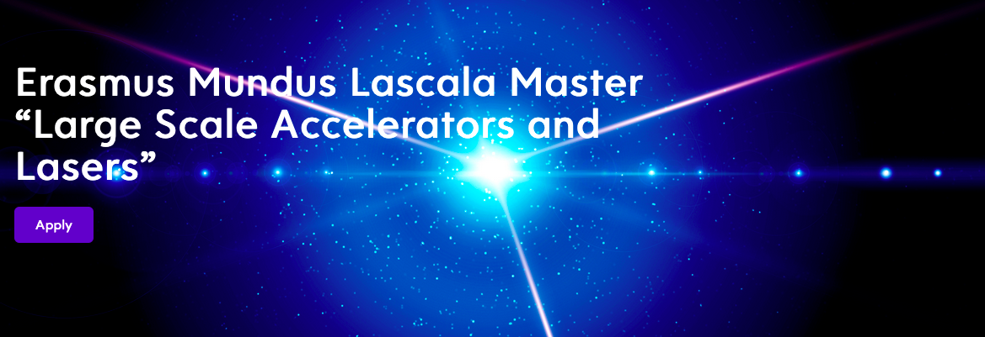
MASTER PROGRAM LASCALA: STUDENTS ARE LOOKING FOR 5-6 MONTHS MASTER THESIS
IN THE FIELD OF INTENSE LASERS/PLASMAS
SPRING/SUMMER 2023
https://www.master-lascala.eu/

Slide 2
MASTER PROGRAM LASCALA: STUDENTS ARE LOOKING FOR 5-6 MONTHS MASTER THESIS
IN THE FIELD OF INTENSE LASERS/PLASMAS, SPRING/SUMMER 2023
The students did lab work at Frascati or Lund, will spend another one semester in Paris Saclay
With specific lectures and practicals on plasmas and french laser installations, they are 20
PLEASE send internship offers or any further question to : sophie.kazamias@university-paris-saclay.fr
We will put them on the master website for all the students

